Slide 1
Operators in Java
Week 3

Slide 2
Agenda
Recap of Last Lecture
Operators, Operand, and Operation
Arithmetic Operators
Incremental and Decremental Operators
Relational Operators
Bitwise Operators
Bitwise Shift Operators
Logical Operators
Assignment Operator
Ternary Operator
Recap of Operators

Slide 3
Operator, Operands, and Operation
Operators mean which perform any operator
Operands mean on which operation is performed
The process is called operation
For example: c = a + b
In above expression, + and = are operators they perform addition and assignment operation. a, b, and c are the operands on which operation is performed. Finally, addition and assignment are the operations.

Slide 4
Operators in Java
Arithmetic Operators
Incremental and Decremental Operators
Relational Operators
Bitwise Operators
Bitwise Shift Operators
Logical Operators
Assignment Operator
Ternary Operator

Slide 5
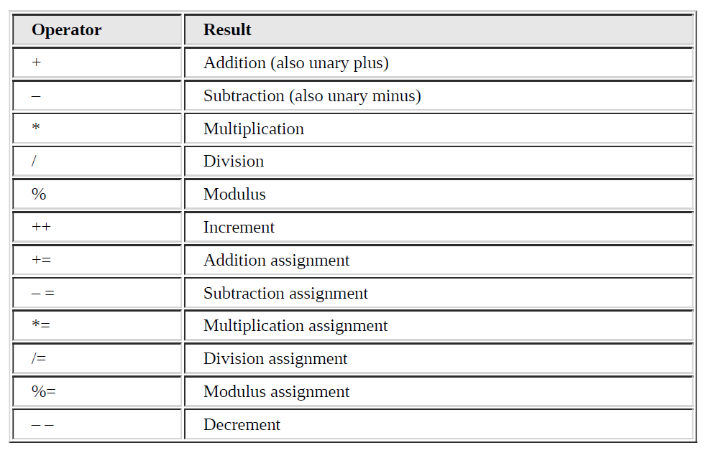
Arithmetic Operators in Java

Slide 6
Arithmetic Operators in Java
Which perform mathematical operations.
Three types
  Basic Arithmetic Operators
  Arithmetic Compound Assignment Operators
  Incremental and Decremental Operators

Slide 7
Basic Arithmetic Operators in Java
Operator | Results
+ | Addition
- | Subtraction
* | Multiplication
/ | Division
% | Modulus

Slide 8
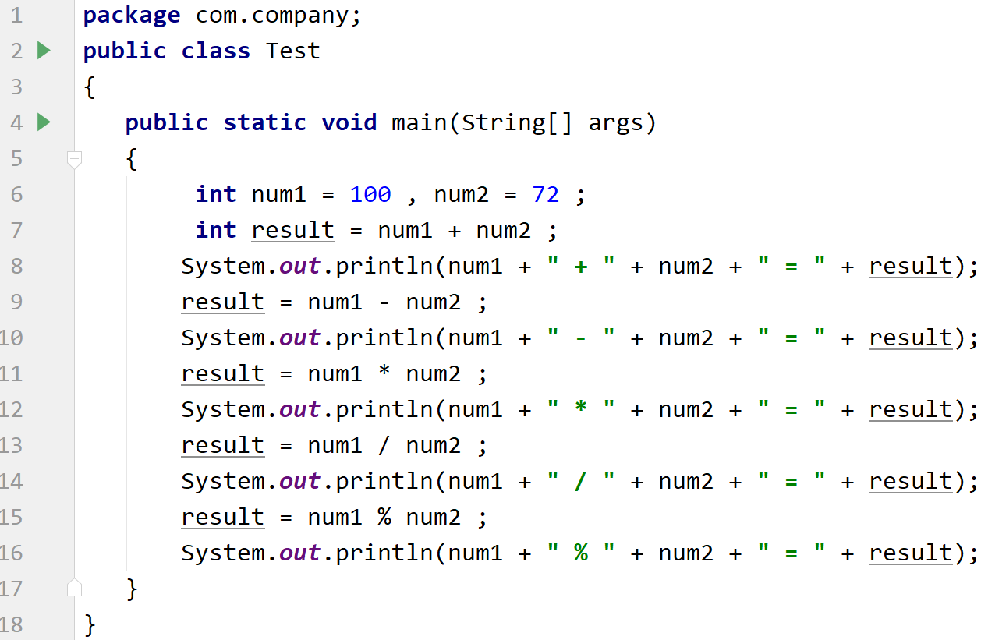
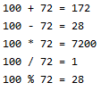
Basic Arithmetic Operators in Java
Output

Slide 9
Arithmetic Compound Assignment Operators
combine an arithmetic operation with an assignment.
Operator | Results
+= | Addition Assignment
-= | Subtraction Assignment
*= | Multiplication Assignment
/= | Division Assignment
%= | Modulus Assignment

Slide 10
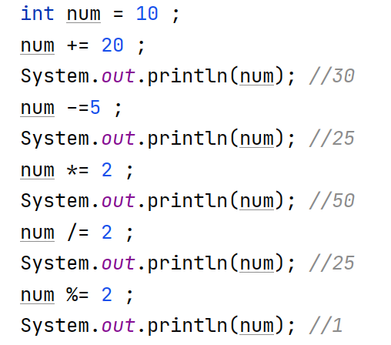
Arithmetic Compound Assignment Operators

Slide 11
Incremental / Decremental Operators in Java
These are the unary operators.
Unary operators are those operators in Java that only need a single operand to perform any function.
Incremental operator (++): Increase the value of a variable by 1
  Pre-incremental (++a): First increase then assign.
  Post incremental (a++): First assign then increase
Decremental operator (--): Decrease the value of a variable by 1
  Pre-decremental (--a): First decrease then assign
  Post decremental (a--): First assign then decrease

Slide 12
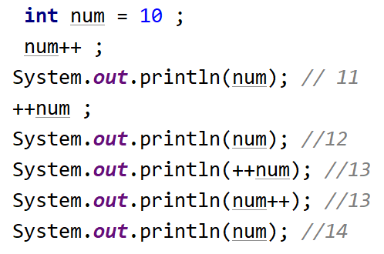

Output

Slide 13
Relational Operators in Java
The relational operators determine the relationship that one operand has to the other. Specifically, they determine equality and ordering. The outcome of these operations is a Boolean value.
Operator | Results
== | Equal to
!= | Not Equal to
< | Less than
<= | Less than or equal to
> | Greater than
>= | Greater than or equal to

Slide 14
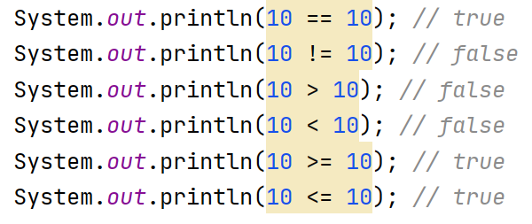
Relational Operators in Java

Slide 15
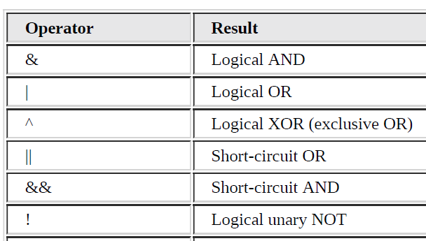
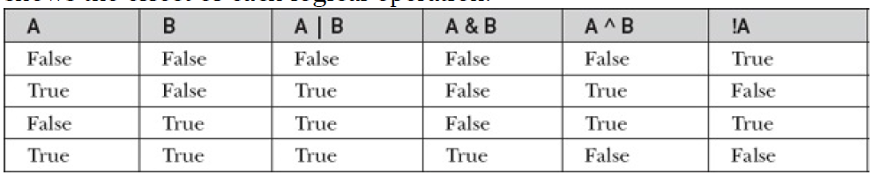
Logical Operators in Java
Operate only on boolean operands and the result is also boolean.
If you use the || and && forms, rather than the | and & forms of these operators, Java will not bother to evaluate the right-hand operand when the outcome of the expression can be determined by the left operand alone.

Slide 16
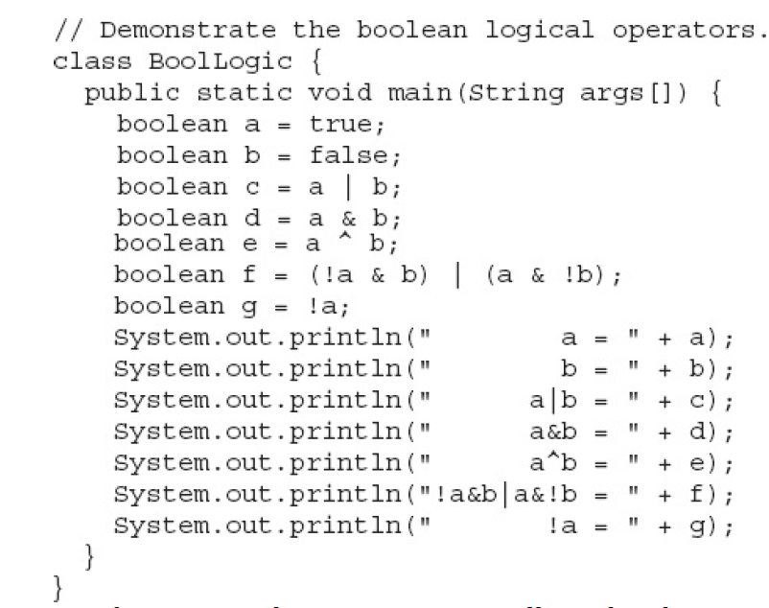
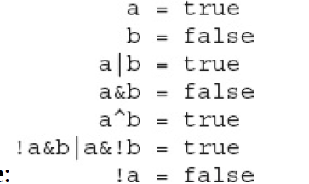
Logical Operators in Java
Output

Slide 17
Assignment Operator
The assignment operator is the single equal sign, =.
The assignment operator assigns the value to the variable.
Example: int a = 10 ;

Slide 18
Ternary Operator
Java includes a special ternary (three-way) operator that can replace certain types of if-then-else statements.
This operator is the ?.
The ? has this general form:
  expression1 ? expression2 : expression3
If expression1 is true, then expression2 is evaluated; otherwise, expression3 is evaluated.
The result of the ? operation is that of the expression evaluated.

Slide 19
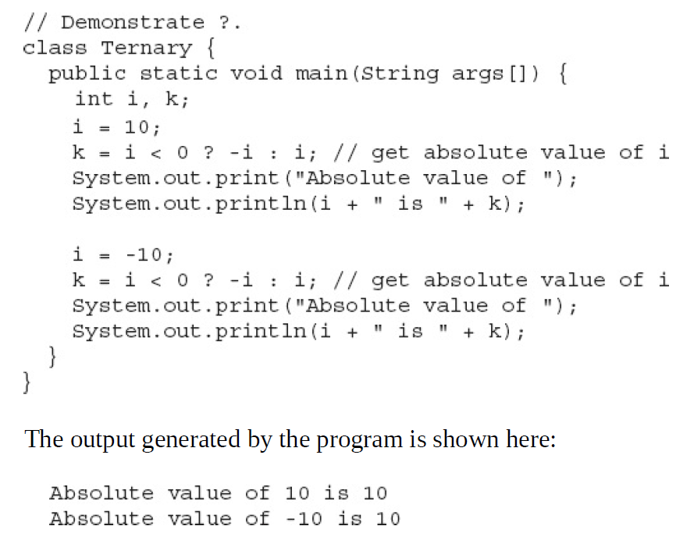
Ternary Operator

Slide 20
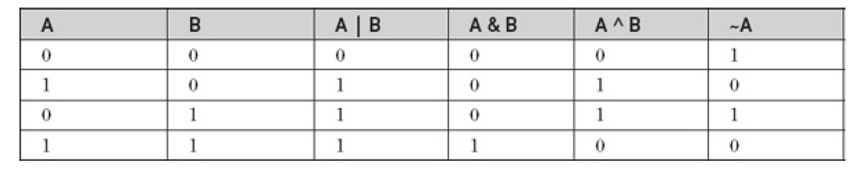
Bitwise Operators
The bitwise logical operators are &, |, ^, and ~.
Need integer operands. Result is also integer.

Slide 21
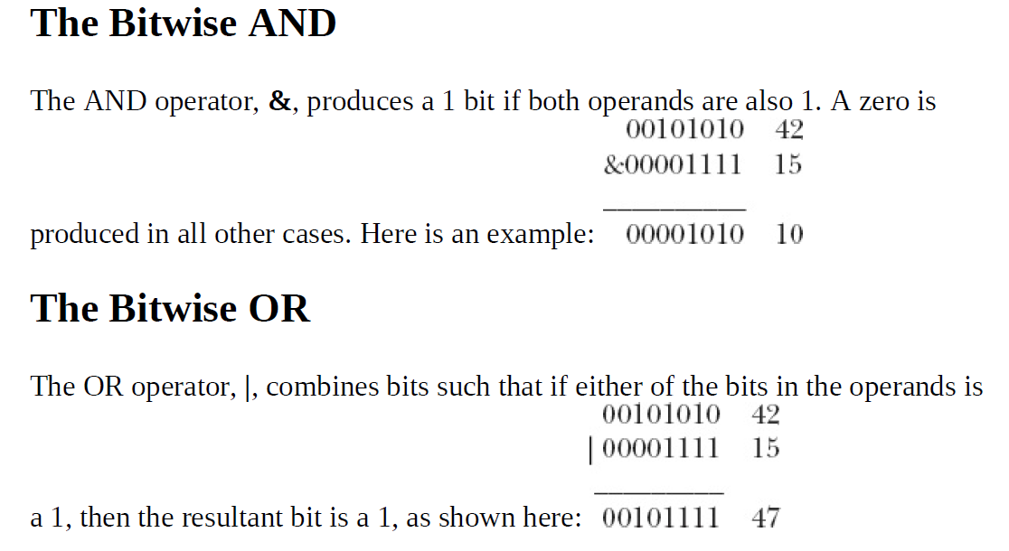


Bitwise Operators

Slide 22
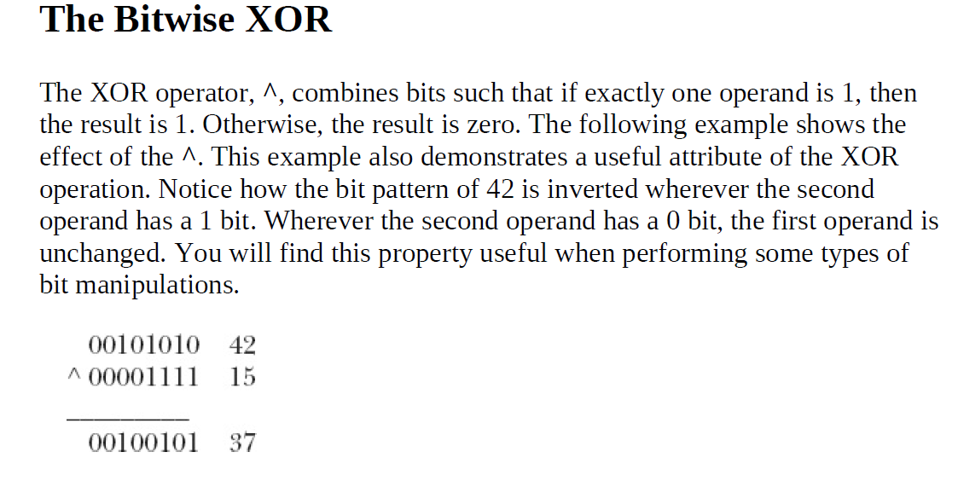
Bitwise Operators

Slide 23
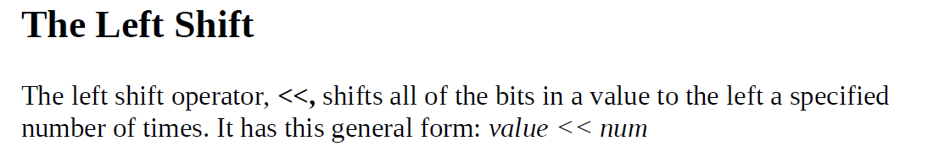
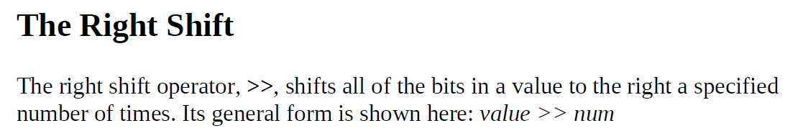
Shift Operators

Slide 24
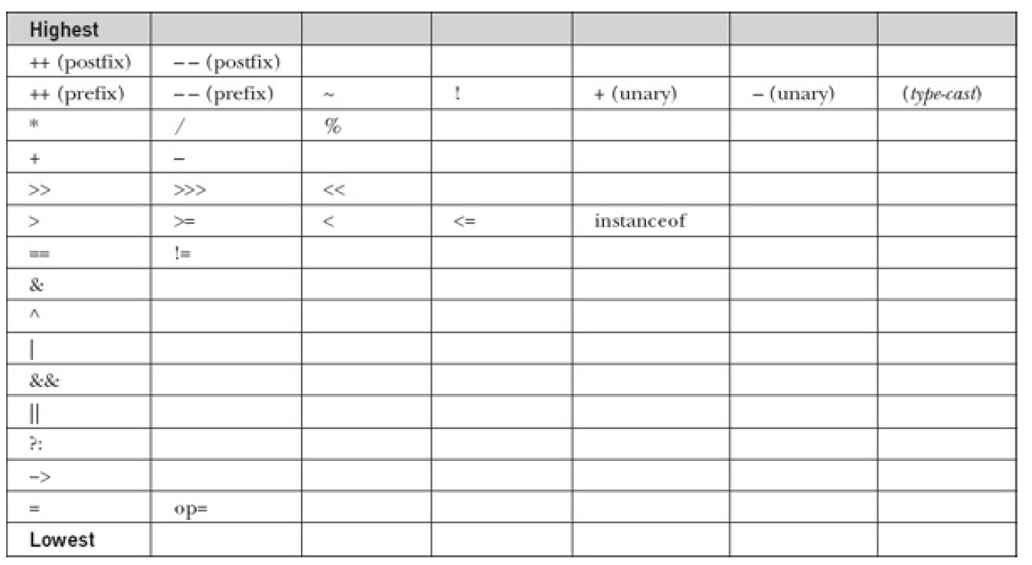
Operator Precedence

Slide 25
Recap
Operators, Operand, and Operation
Arithmetic Operators
Incremental and Decremental Operators
Relational Operators
Bitwise Operators
Bitwise Shift Operators
Logical Operators
Assignment Operator
Ternary Operator

